Slide 1

CLT,Hypothesis Testing,Types of Errors,P value
May 2018
Bangalore
May 2018
Bangalore

Slide 2
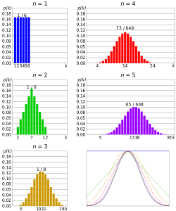
The Central Limit Theorem states that the sampling distribution of the sample means approaches a normal distribution as the sample size gets larger — no matter what the shape of the population distribution. This fact holds especially true for sample sizes over 30. All this is saying is that as you take more samples, especially large ones, your graph of the sample means will look more like a normal distribution.
The picture below shows one of the simplest types of test: rolling a fair dice.
An essential component of the Central Limit Theorem is that the average of your sample means will be the population mean.

Slide 3
➢ What is Hypothesis?
• An educated guess
• A claim or statement about a property of a population
➢ What is the goal of Hypothesis Testing?
• To analyze a sample in an attempt to distinguish between population characteristics, that are likely to occur and
population characteristics that are unlikely to occur.
➢ Null Hypothesis
• Statement about the value of a population parameter
• Represented by H0
• Always stated as an Equality
➢ Alternative Hypothesis
• Statement about the value of a population parameter that must be true if the null hypothesis is false
• Represented by H1
• Stated in on of three forms
• Less than
• Greater than
• Not equal to

Slide 4
Step 1 – Start the Null Hypothesis
Step 2 – State the Alternative Hypothesis
Step 3 – Set alpha
Step 4 – Calculate a test statistic
Step 5 – Construct Acceptance/Rejection Regions
Step 6 – Make Conclusions

Slide 5
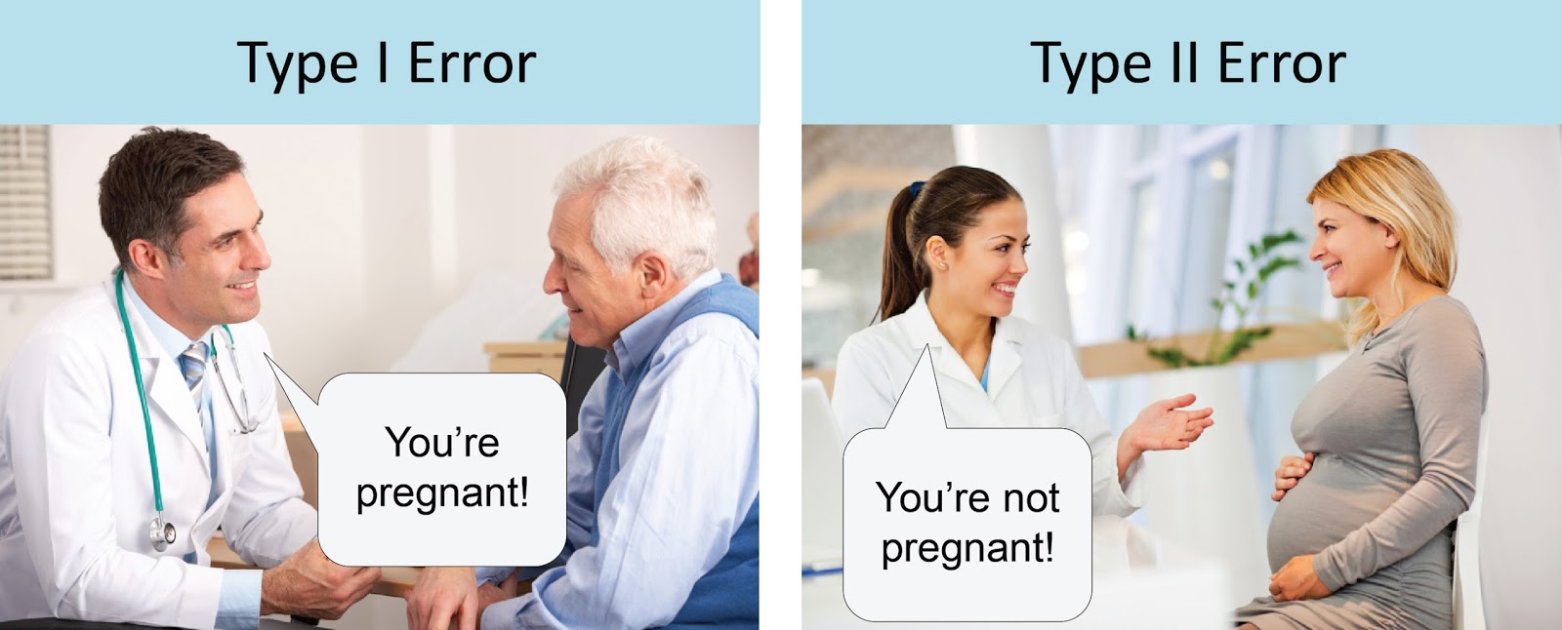
➢ Type I Error
• A type I error is the incorrect rejection of a true null hypothesis (a "false positive"), while a type II error is the
failure to reject a false null hypothesis (a "false negative")
• Examples of type I error includes a test that shows a patient to have a disease when in fact the patient does not
have the disease, a fire alarm going off indicating a fire when in fact there is no fire.
➢ Type II Error
• A type II error (or error of the second kind) is the failure to reject a false null hypothesis.
• Examples of type II errors would be a blood test failing to detect the disease it was designed to detect, in a
patient who really has the disease, a fire breaking out and the fire alarm does not ring.

Slide 6
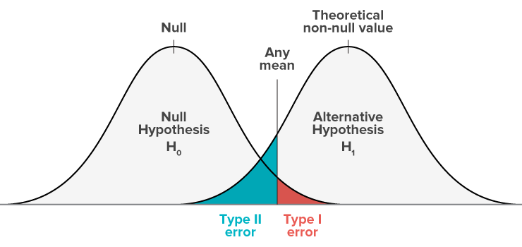

Slide 7
➢ P-Value - In statistical significance testing, the p-value is the probability of obtaining a test statistic at least as extreme
as the one that was actually observed, assuming that the null hypothesis is true.
➢ Significance level - The probability of rejecting the null hypothesis is when it is called the significance level ‘α’.
Note: If the p-value is equal to or smaller than the significance level (α), it suggests that the observed data is inconsistent with the assumption that the null hypothesis is true and thus this hypothesis must be rejected (but this does not automatically mean the alternative hypothesis can be accepted as true).

Slide 8
➢ α is the probability of Type I error
➢ β is the probability of Type II error
➢ That level is called the level of significance for the test. Changing α can (and often does) affect the results of the test—whether you reject or fail to reject H0.
➢ As α increases, β decreases and vice versa.
➢ The only way to decrease both α and β is to increase the sample size. To make both quantities equal zero, the sample size would have to be infinite- you would have to sample the entire population.

Slide 9
➢ Describe the population characteristic about which hypotheses are to be tested.
➢ State the null hypothesis, Ho
➢ State the alternative hypothesis, H1 or Ha
➢ Display the test statistic to be used.
➢ Identify the rejection region.Is it an upper, lower, or two-tailed test?
➢ Determine the critical value associated with ‘α’, the level of significance of the test.
➢ Compute all the quantities in the test statistic, and compute the test statistic itself.
➢ State the conclusion. That is, decide whether to reject the null hypothesis Ho, or not to reject the null hypothesis.

Slide 10
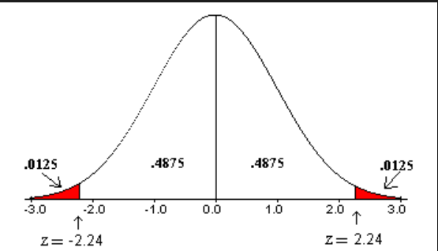
Z Test
A Z-test is a type of hypothesis test. Hypothesis testing is just a way for you to figure out if results from a test are valid or repeatable. For example, if someone said they had found a new drug that cures cancer, you would want to be sure it was probably true. A hypothesis test will tell you if it’s probably true, or probably not true. A Z test, is used when your data is approximately normally distributed.

Slide 11
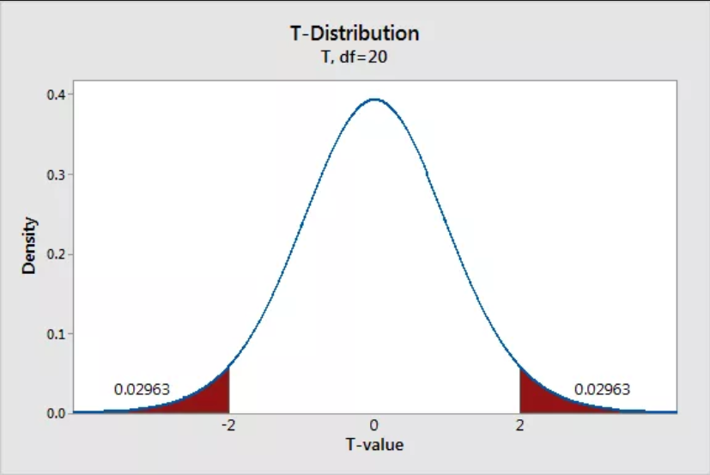
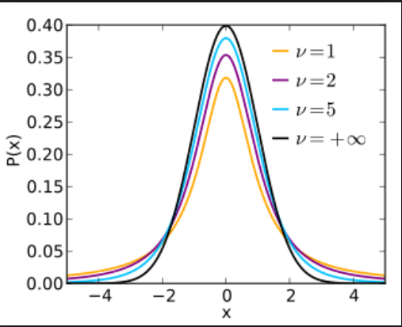
T Test
The T distribution (also called Student’s T Distribution) is a family of distributions that look almost identical to the normal distribution curve, only a bit shorter and fatter. The t distribution is used instead of the normal distribution when you have small sample. The larger the sample size, the more the t distribution looks like the normal distribution. In fact, for sample sizes larger than 20 (e.g. more degrees of freedom), the distribution is almost exactly like the normal distribution.

Slide 12
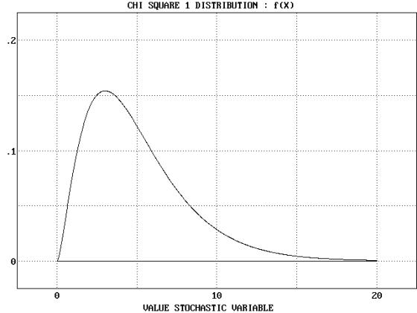
Chi-Square (χ²)
Any number squared is a positive number
Therefore, area under the curve starts at 0 and goes to infinity
To be statistically significant, needs to be in the upper 5% (α = .05)
Compares observed frequency to what we expected

